Slide 1
EQUALIZER A Scalable Parallel Rendering Framework
Stefan Eilemann, Maxim Makhinya, and Renato Pajarola
Presented by Group – 10
Divyansh Mittal 210358
Lakshvant Balachandran 210557
Parthapratim Chatterjee 210705

Slide 2
Introduction
Faster CPUs & GPUs -> Hardware Parallelism -> Complexity of Data
Drawbacks of Previous Parallel Rendering Approaches :-
Limited Domain-Specific Solutions
Lack of Scalability
Lack of Reuse of Existing Code
Notes:
Limited Domain-Specific Solutions
Traditional systems often support generic applications, lacking custom solutions for specific fields like molecular visualization or geospatial rendering.
Scalable Graphics Abstraction
Difficulty in abstracting the graphics layer for scalable and adaptive rendering across different hardware configurations and environments.
Lack of Reuse of Existing Code
Challenges in leveraging existing proprietary codebases such as scene graphs, LOD, and geometry databases, making integration difficult in parallel or distributed systems.

Slide 3
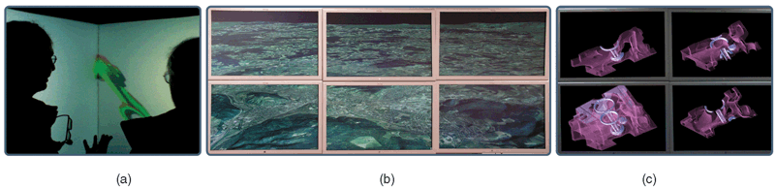
What is Equalizer?
A toolkit for scalable parallel rendering based on OpenGL
Notes:
, which provides an application programming interface (API) to develop scalable graphics applications for a wide range of systems ranging from large distributed visualization clusters and multiprocessor multipipe graphics systems to single-processor single-pipe desktop machines
(a) Immersive CAVE. (b) Display wall. (c) Scalable volume rendering.

Slide 4
Why Equalizer?
Compound Trees for Resource Flexibility
Simple Task Decomposition & Compositing
Automatic Task Distribution
Decentralized Architecture
Low-Latency Synchronization
Minimally Invasive Programming
Notes:
Compound Trees for Resource Flexibility
Introduces compound trees for flexible configuration of graphics system resources.
Simple Task Decomposition & Compositing
Allows easy specification of parallel task decomposition and image compositing using compound tree layouts.
Automatic Task Distribution
Enables automatic decomposition and distributed execution of rendering tasks via the compound tree.
Support for Surface & Volume Rendering
Handles both parallel surface rendering and transparent volume rendering with z-visibility and α-blending compositing.
Decentralized Architecture
Fully decentralized system with network swap barriers and distributed objects support.
Low-Latency Synchronization
Offers low-latency frame synchronization and image compositing for distributed environments.
Minimally Invasive Programming
Adopts a minimally invasive programming model, retaining existing code with minimal changes.

Slide 5
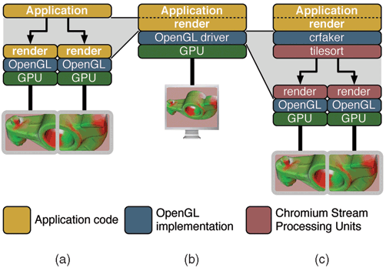
A Comparison
Notes:
For example, one can set up a multiscreen display wall with Chromium, streaming the OpenGL calls to a number of render nodes assigned to screen tiles of the display wall, as illustrated in Fig. 2c. One instance of the application is running. In contrast, Equalizer runs parts of the application in parallel on multiple rendering channels as illustrated in Fig. 2a

Slide 6
System Architecture
Interface
Application
Rendering Client
Equalizer Server
Compound Trees

Slide 7
Interface
C++ Class based Framework
Overrides Task Methods
System-wide configurational Server
Peer-to-Peer Network Layer; TCP/IP Sockets and InfiniBand
No MPI !!
Parallel data access and distribution problem

Slide 8
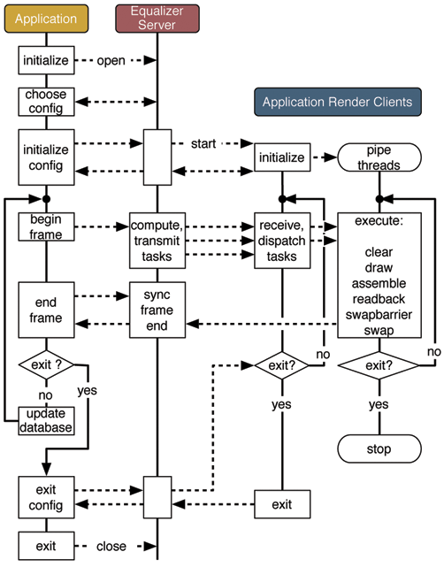
Application

Slide 9
Rendering Client
Main thread, network thread, and one per GPU for rendering tasks
Receives task parameters from the server via network
Controlled entirely by the Equalizer framework; no main loop required

Slide 10
Equalizer Server
Receives application requests
Launch, Assign, Synchronize
Maintains Compound Tree
Resource Hierarchy – Nodes, Pipes, Threads, Windows, Channels
Window
Pipe
Node
Pipe
Window

Slide 11
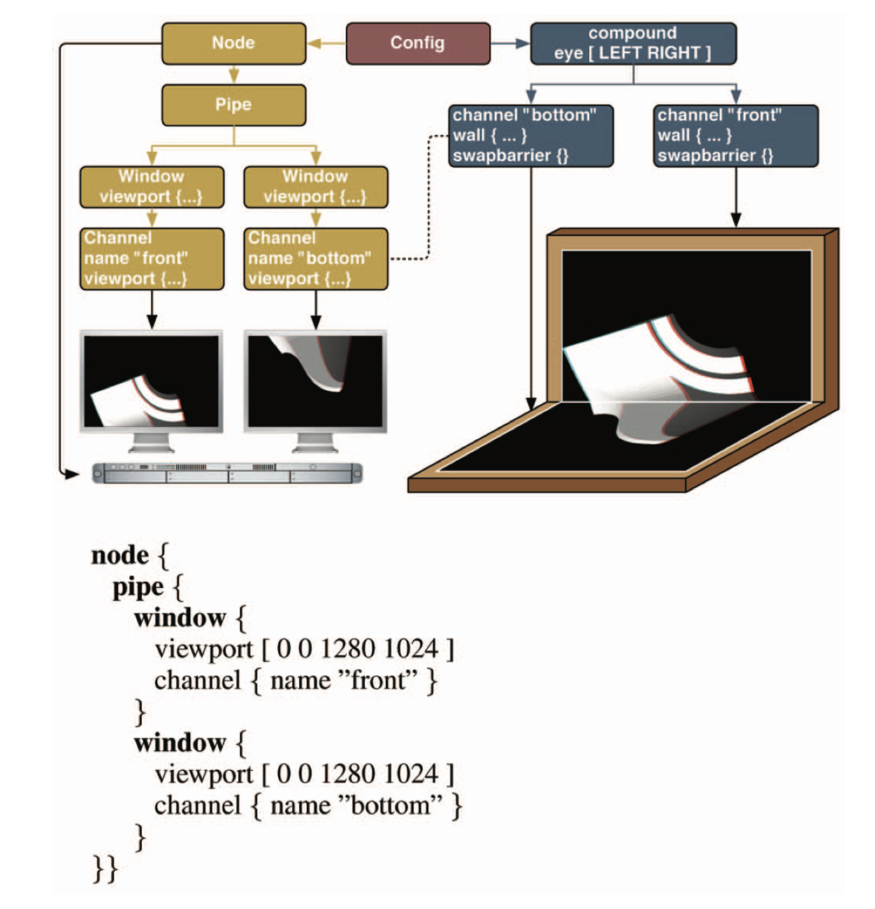
What are Compound Trees?
A compound tree is a data structure used to manage parallel rendering tasks in Equalizer.
It allows distributing rendering jobs efficiently across hardware resources.
Nodes in the tree represent tasks such as rendering, compositing, and assembling images.
Notes:
Compounds are data structures that describe parallel rendering tasks (like clear, draw, assemble, and readback). They reference channels, which represent physical rendering resources (like GPUs or windows).
Input and Output Frames are used to manage the flow of rendered data between compounds, and they are linked by name to ensure proper data transfer through the pipeline.
Compound Trees provide a logical structure of the rendering pipeline. They define how the tasks are organized and how data flows but only reference physical resources (like GPUs) via channels.
Flexibility: By simply changing the channel IDs, the compound tree can be mapped to different physical setups (e.g., multi-GPU systems or local machines with multiple windows), allowing for easy testing and scalability.

Slide 12
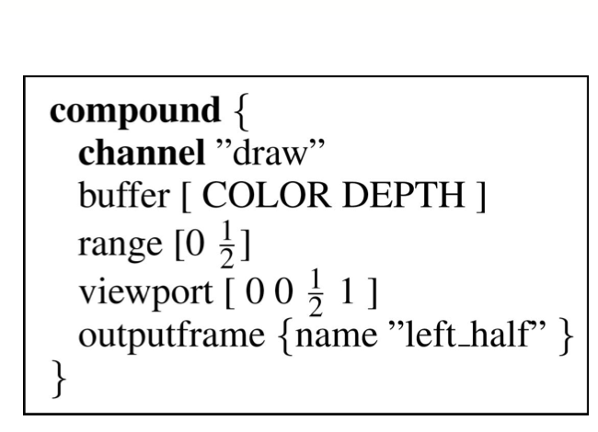
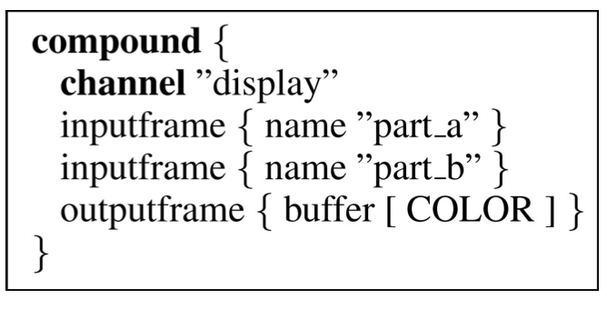
Basic Structure of a Compound Tree
Leaf Nodes: Handle specific rendering tasks such as rendering a portion of the image.
Non Leaf Nodes: Assemble or composite results from child nodes.
Notes:
Child inhert attributes from parent

Slide 13
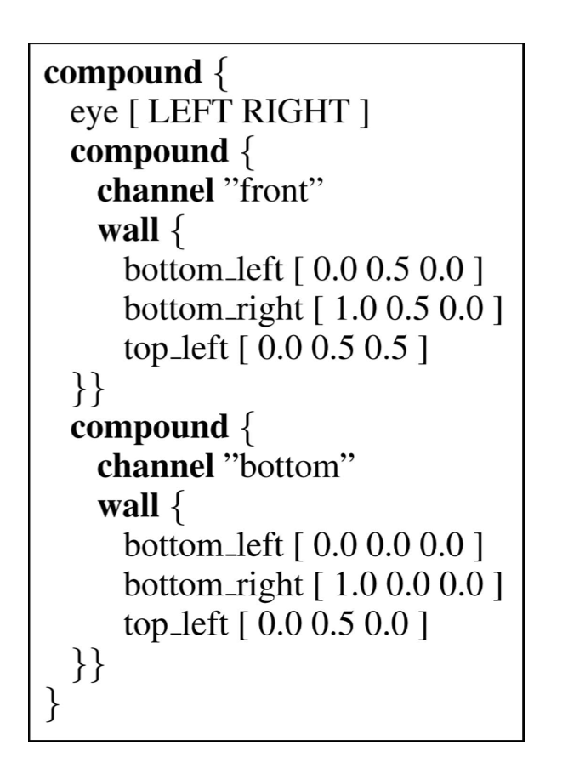
Decomposition - Attributes
Compounds have attributes that configure the decomposition of the destination channel’s viewport, frustum, and database.
Viewport decomposition divides the destination’s channel viewport in screen space.
Frustum decomposition adjusts the view frustum for 3D space rendering.
Database decomposition allows specific parts of the scene to be rendered.
Stereo passes selectively render left or right eye views for 3D stereo applications.
Notes:
Attributes are inherited
Viewport Decomposition:
A viewport refers to the area of the screen (in 2D pixel space) where rendering will occur. Compounds can configure how the destination channel’s viewport is decomposed. For example, the viewport can be split into smaller sections, allowing different parts of the scene to be rendered by different compounds.
Frustum Decomposition:
The view frustum is a 3D space defined by the camera's field of view, near and far clipping planes, and aspect ratio. Compounds can adjust the frustum to specify which part of the 3D scene should be rendered.
This is important for parallel rendering since different view frustums can be assigned to different channels (or GPUs) to render distinct parts of the scene.
Database Decomposition:
A range attribute tells the application to render a portion of its data (the scene database). This could be a subset of objects or geometry in the scene, allowing different portions of the database to be processed in parallel.
Stereo Rendering Passes:
Compounds can also specify an eye rendering pass, which selects the appropriate stereo rendering pass. This is used to render the left-eye or right-eye view in stereoscopic (3D) rendering applications.
Cumulative Attributes:
Attributes are cumulative, meaning that the attributes of intermediate compounds affect the rendering performed by their children. For example, if an intermediate compound changes the viewport or frustum, that decomposition is applied to all of its child compounds, ensuring that the rendering is consistently decomposed across the hierarchy.

Slide 14
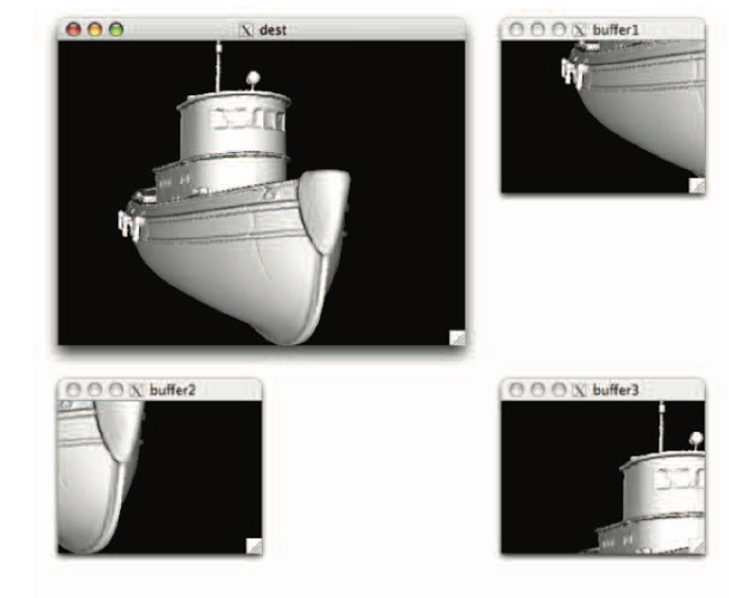
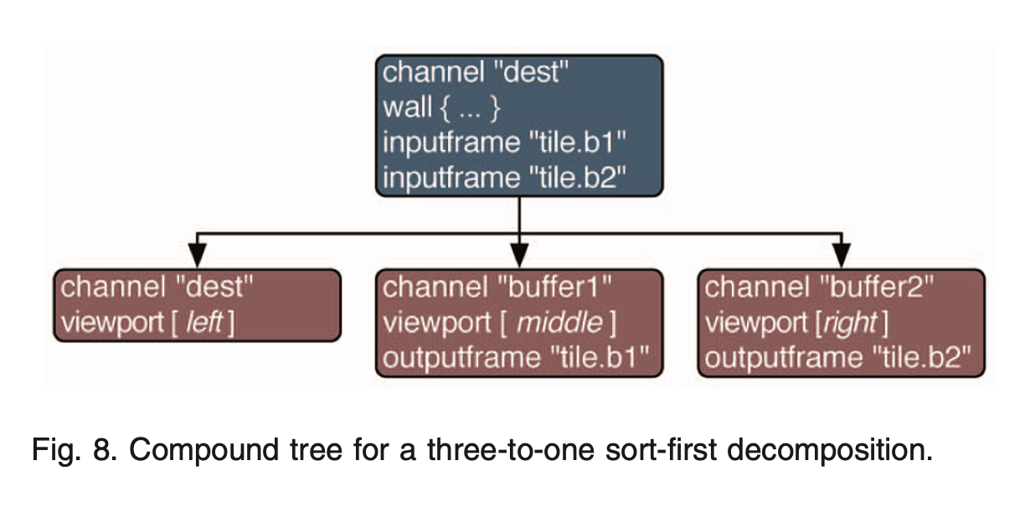
Example - Sort- First Rendering
Sort-First rendering splits screen into tiles, each rendered in parallel.
Root Node represents the entire screen.
Child Nodes render specific tiles.
Final Composition: Tiles are assembled to form the image

Slide 15
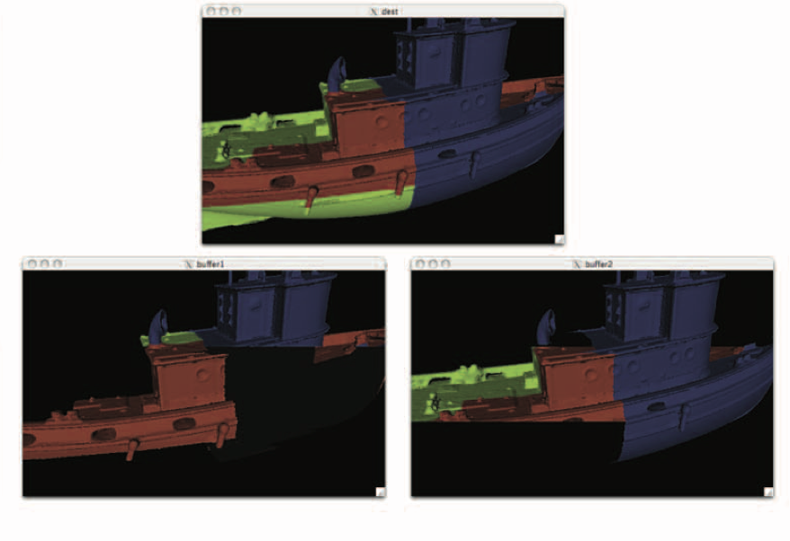
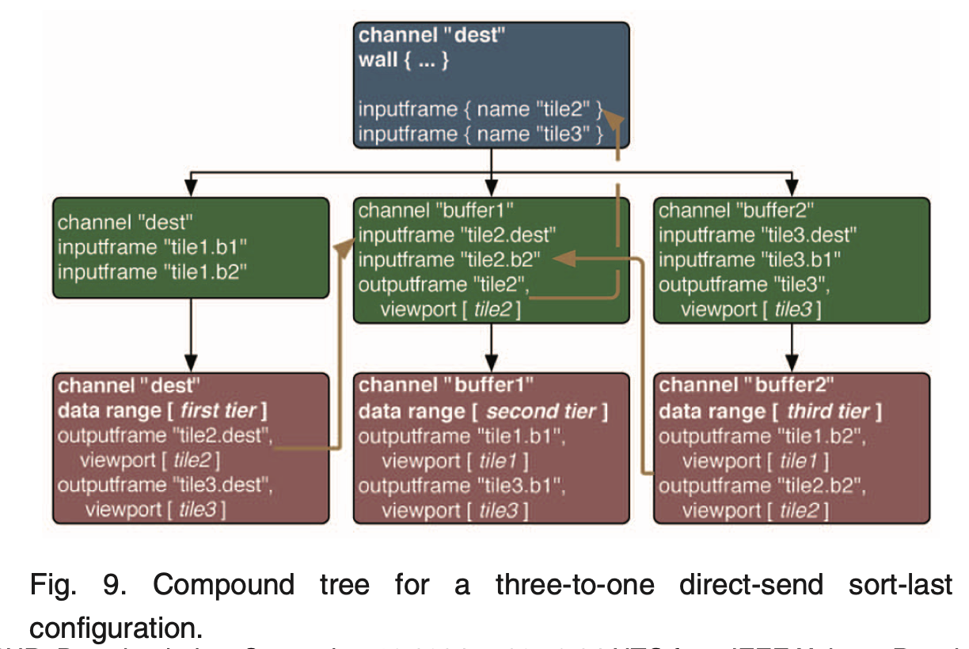
Example - Sort-Last Rendering
Sort-Last rendering splits data into portions, each rendered independently.
Leaf Nodes render specific portions of the data.
Intermediate Nodes handle compositing based on depth information.
Root Node assembles the final image

Slide 16
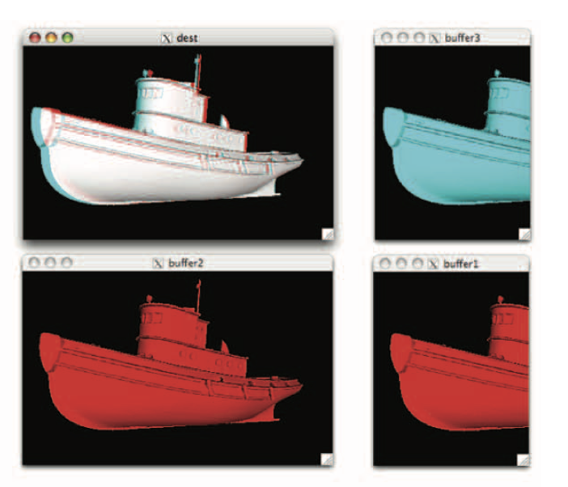
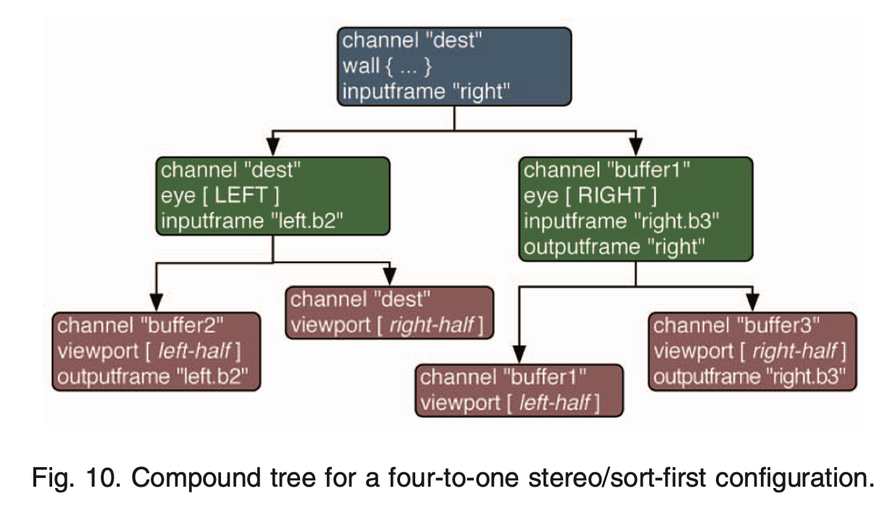
Stereo sort first Rendering
Stereo rendering creates two images, one for the left eye and one for the right eye.
Stereo Decomposition: Splits task into left-eye and right-eye views. Each eye’s task can be further parallelized.
Final Image: Combines both images to create a 3D effect.

Slide 17
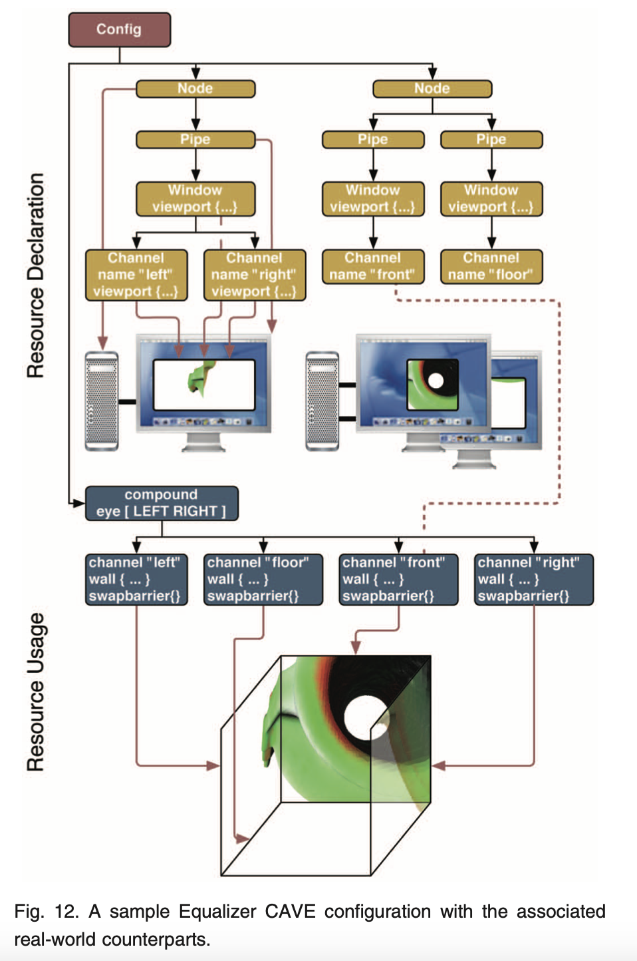
Multi-Screen Rendering with Compound Trees
Multi-screen setups like CAVEs can be managed using compound trees.
Each screen has its own rendering task, and the root node ensures synchronization across screens.
This allows high-resolution rendering across a large display area.

Slide 18
Benefits of Compound Trees
• Efficient use of multi-GPU and multi-node systems.
• Supports complex configurations for different display setups (CAVE, multi-screen).
• Asynchronous execution to improve performance by reducing synchronization waits.
• Customizable task decomposition based on hardware and workload.

Slide 19
Data Consistency ?
Distributed objects are shared data entities used across multiple rendering nodes.They ensure consistent data (e.g., camera position, rendering parameters) across nodes.
The object is registered during initialization in the rendering session.
Synchronization occurs at the beginning of each frame.
Notes:
Subclass the base eqNet::Object class to represent the distributed object.Provide a pointer and size of the data to be distributed across the network.

Slide 20
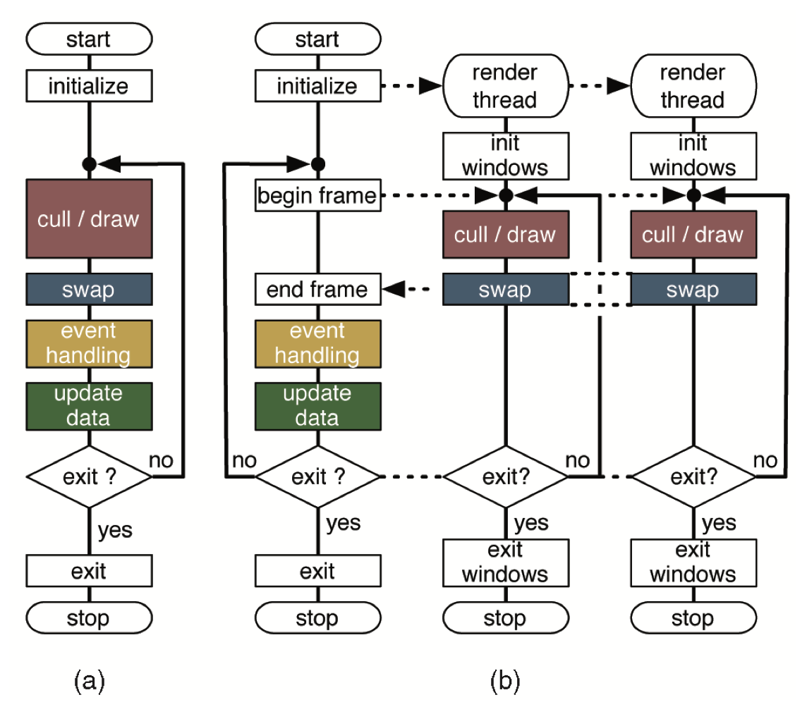
Execution Flow
Traditional OpenGL-based applications rely on a single-threaded rendering loop.
Equalizer extends this model by separating rendering tasks from the main loop.

Slide 21
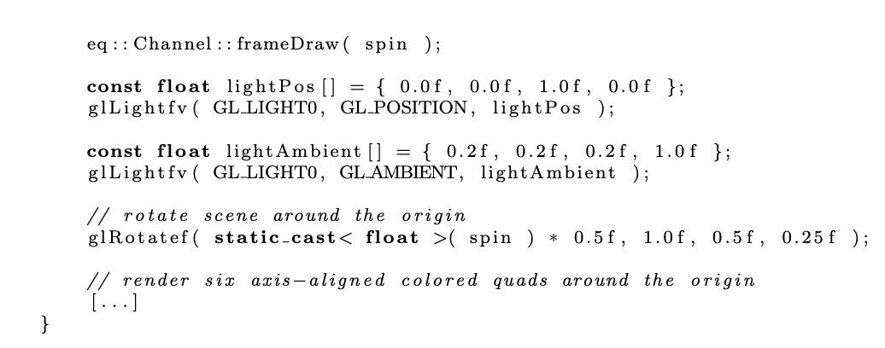
Rendering with Channel::frameDraw
The Channel::frameDraw() method handles the actual rendering.
Equalizer provides OpenGL context, view frustum, viewport, and stereo buffer.
The method must implement view frustum culling and efficient rendering.

Slide 22
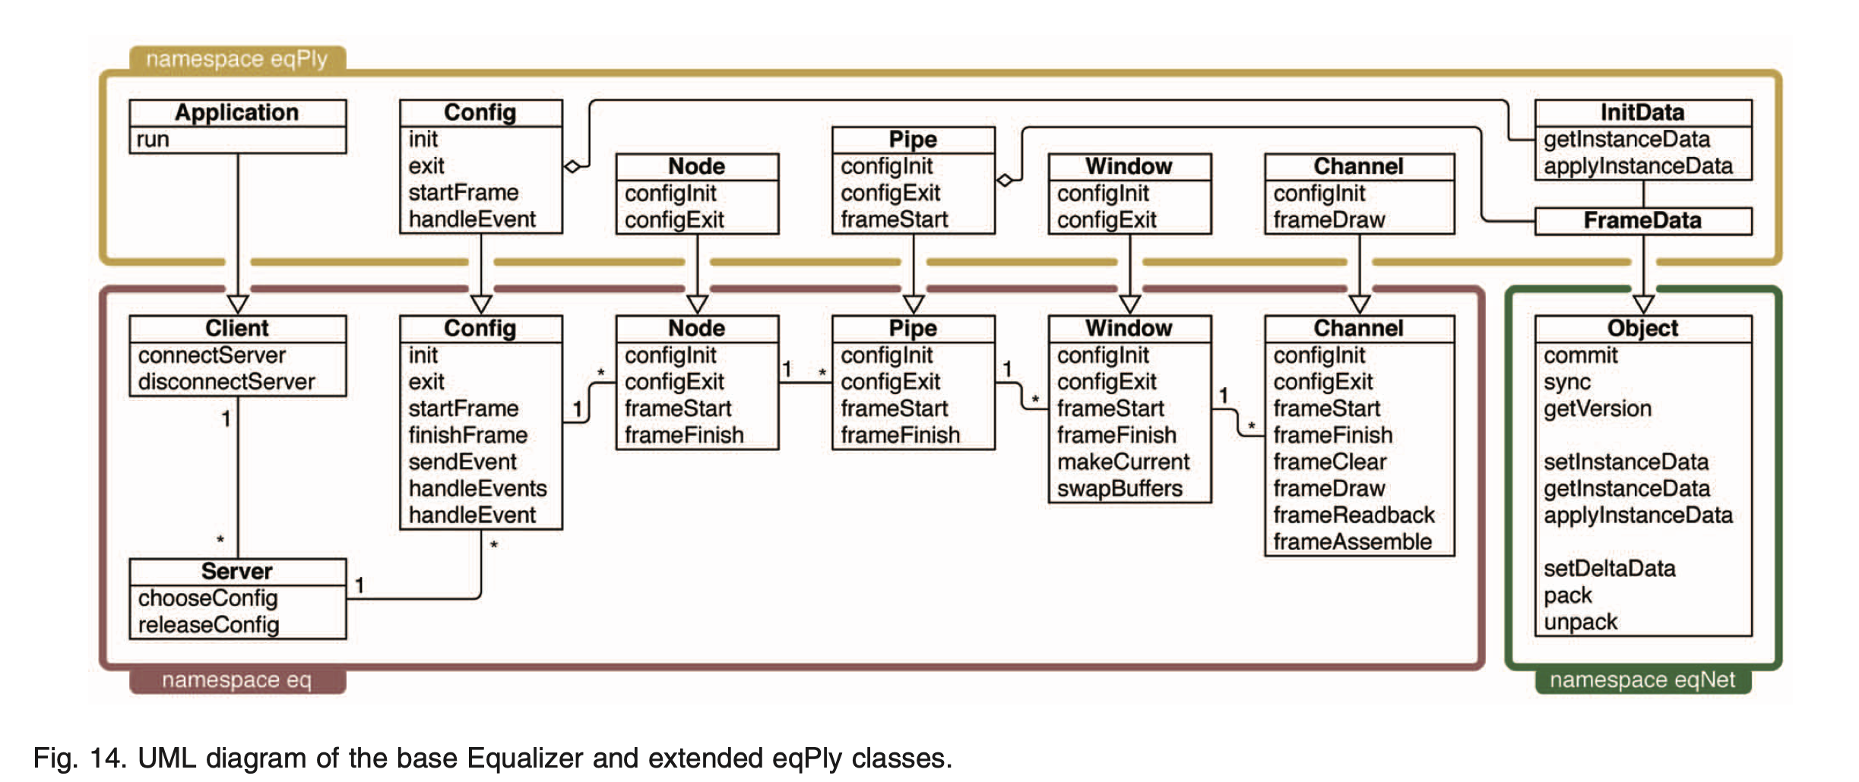
UML Diagram
Notes:
Subclass the base eqNet::Object class to represent the distributed object.Provide a pointer and size of the data to be distributed across the network.

Slide 23
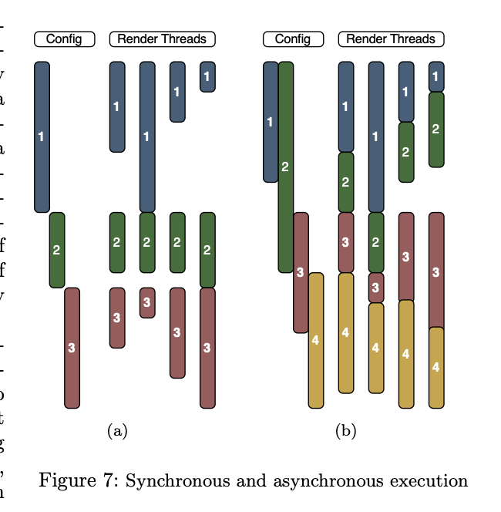
Advanced Rendering and Configurations
lconfig can be used to adjust frame synchronization.
Developers can override additional methods to implement custom rendering behavior:
‘Channel::frameAssemble()‘: Used for custom image assembly techniques (e.g., back-to-front sorting for volume rendering).
Volume rendering applications can benefit from custom frame assembly for accurate rendering
Load balancing is essential for optimizing parallel rendering and this can be controlled using config.
Sort-First: Load is balanced by adjusting the viewport split.
Sort-Last: Load is balanced by adjusting the data range subdivision
Notes:
2. Config-Latency Parameter (lconfig)
To manage the balance between asynchronous and synchronous rendering, Equalizer introduces a config-latency parameter, denoted as lconfig.
How lconfig Works:
lconfig defines how many frames the slowest rendering thread is allowed to fall behind.
For example, if lconfig = 2, a thread can be up to 2 frames behind the slowest thread before synchronization is required.
This means that rendering threads can proceed at their own pace, and only when the frame lag exceeds the lconfig value will the system synchronize the threads.
Frame Synchronization Point:
At the end of frame i, the system will check the completion of frame i - lconfig. If a thread has fallen more than lconfig frames behind, it will be synchronized with the others.
This introduces some flexibility in synchronization, allowing threads to work independently without enforcing frame-by-frame synchronization unless necessary.
lconfig = 0 (Enforcing Synchronous Rendering):
If lconfig = 0, the rendering becomes fully synchronous, meaning that threads will be synchronized at the end of each frame, similar to the behavior in MPK.
lconfig = 0 forces frame synchronicity if needed, ensuring that all threads complete a frame before proceeding to the next.

Slide 24
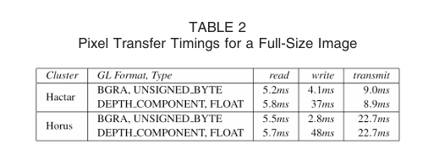
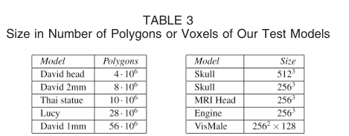
Test Environment and Data Overview
The experiments were conducted on two clusters:
Hactar (6 nodes with Geforce 7800 GTX graphics cards, Myrinet network).
Horus (16 nodes with Quadro FX4500 graphics cards, 1 Gbps Ethernet network).
Two test applications were used:
eqPly (polygonal data rendering).
eVolve (direct volume rendering).
The performance results are based on large 3D data sets like the Thai statue, Lucy, and David models.
Notes:
BGRA, UNSIGNED_BYTE: Represents an 8-bit per channel format for color data (Blue, Green, Red, Alpha channels).
DEPTH_COMPONENT, FLOAT: A floating-point format used for depth buffer (z-buffer), which stores depth information (distance from the camera) for each pixel.

Slide 25
Decomposition Modes
Sort Last Rendering
Sort First Rendering
Stereo Sort First Rendering

Slide 26
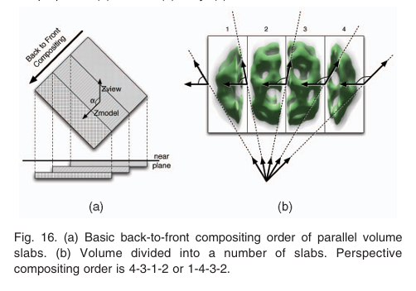
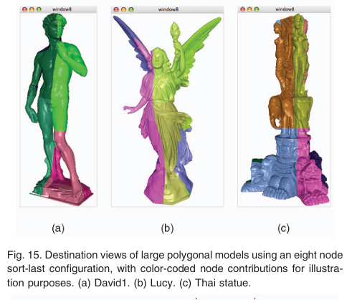
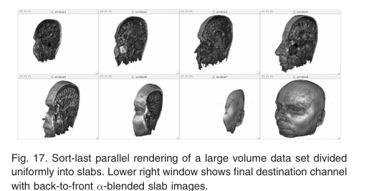
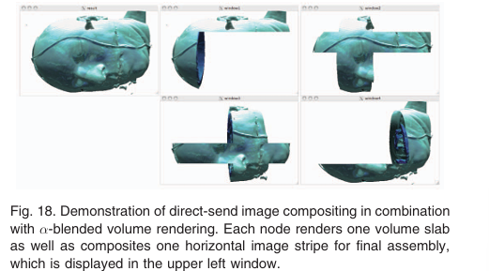
Sort Last Rendering
In Sort-Last, data is divided, rendered separately, and composited based on depth:
• Suitable for large datasets or complex scenes.
• Example: Volume rendering by dividing the volume into slabs.
• Final image assembly performed using z-depth compositing.

Slide 27
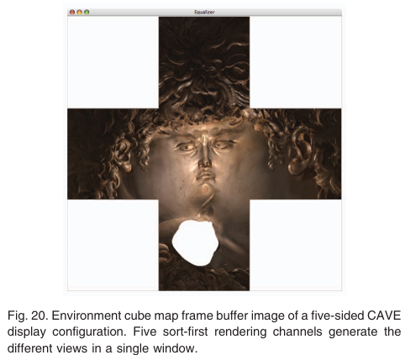
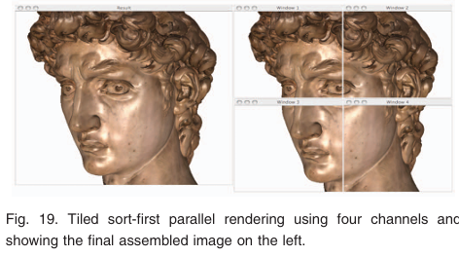
Sort First Rendering
Equalizer uses a sort-first decomposition method to split the scene into different viewports.
Each node renders the portion of the scene visible from its assigned viewpoint.
The rendering task for each screen is handled separately, and there is no need for complex compositing, as each screen has a dedicated view

Slide 28
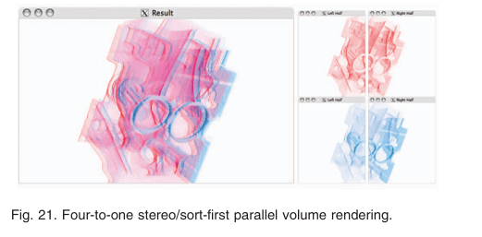
Stereo Sort First Rendering
To achieve the 3D effect, stereoscopic rendering is applied. Each node generates two images: one for the left eye and one for the right eye, which are projected in a way that creates depth perception when viewed through 3D glasses.
Equalizer’s compound tree handles stereo decomposition, splitting the rendering task into left-eye and right-eye views, and then further decomposing the screen space into individual channels for each screen.

Slide 29
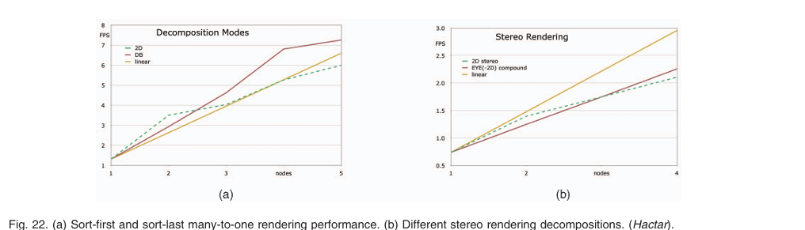
Performance Benchmarks (Hactar)
Tested with Thai statue model (100 frames):
• Sort-First: Linear speedup; trivial tile assembly on the destination channel.
• Sort-Last: Excellent scalability with direct-send compositing.

Slide 30
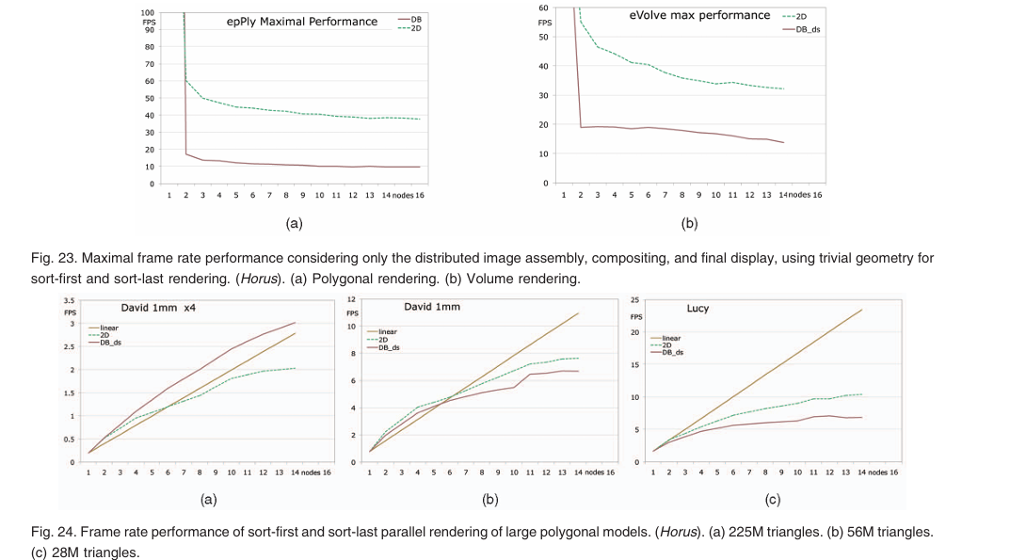
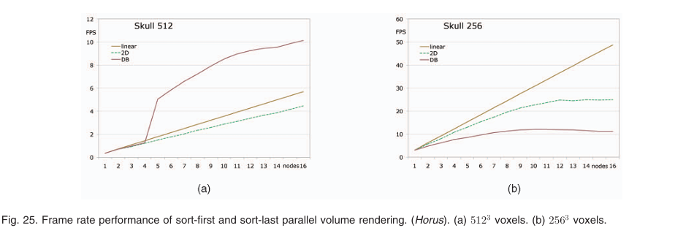
Performance Benchmarks (Horus)
Evaluating system bottlenecks with pixel readback, transmission, z-compositing:
• Sort-First: Polygonal rendering limited to 35 FPS, volume rendering with back-to-front blending.
• Sort-Last: Achieved near-linear speedup in large datasets (225M triangles, 512³ voxels).
Notes:
Sort-first rendering (2D) achieves better and more stable performance for polygonal rendering in epPly compared to sort-last (DB) rendering.
The drop in FPS for DB is likely due to the communication overhead and depth-buffer compositing required for sort-last rendering, which introduces additional delay
The performance reaches a limit when the cost of inter-node communication and depth-buffer compositing outweighs the benefits of dividing the workload further.

Slide 31
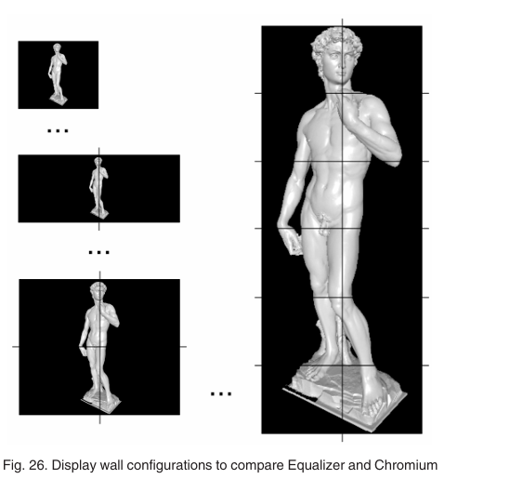
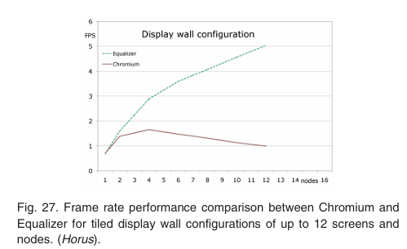
Equalizer vs Chromium
Equalizer outperforms Chromium in scalability for tiled display wall configurations: • Chromium performance stagnates when more nodes are added. • Equalizer continues to scale well due to distributed parallel frustum culling.

Slide 32
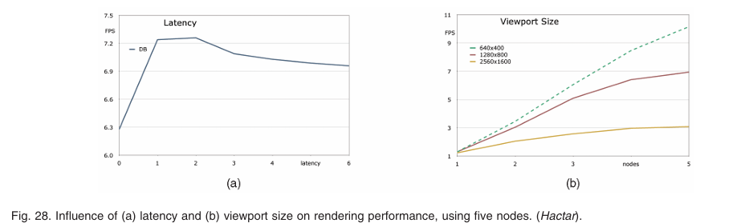
Latency and Viewport Size
Impact of latency and viewport size on performance (sort-last, direct-send):
• Latency: Increased latency by 1-2 frames improves performance by 15%.
• Viewport Size: Performance approaches constant as draw costs reduce by parallelization.

Slide 33
Conclusion
Equalizer Framework
Flexible Compound Tree Structure
Efficient Compositing Algorithms
Support for Sort-First and Sort-Last Rendering
Scalable and Generic Design
Notes:
Equalizer Framework: A state-of-the-art distributed parallel rendering framework for scalable, high-performance visualization.
Flexible Compound Tree Structure: Enables easy specification and execution of complex parallel task decompositions.
Efficient Compositing Algorithms: Achieves excellent scalability, demonstrated with large data sets (e.g., 225M polygonal meshes, 512³ volume data).
Support for Sort-First and Sort-Last Rendering: Efficient handling of both opaque and transparent data with scalable performance.
Scalable and Generic Design: Supports diverse data types, making it suitable for a wide range of scientific and real-world applications.
Challenges: Future work will address dynamic load balancing, improved image compression, and data replication support.

